Slide 1
Excel Basics

Slide 2
Agenda
Navigation in Excel
Fundamentals of Formula Building
Useful Starting Formulas
2
Notes:
2

Slide 3
Navigation in Excel

Slide 4
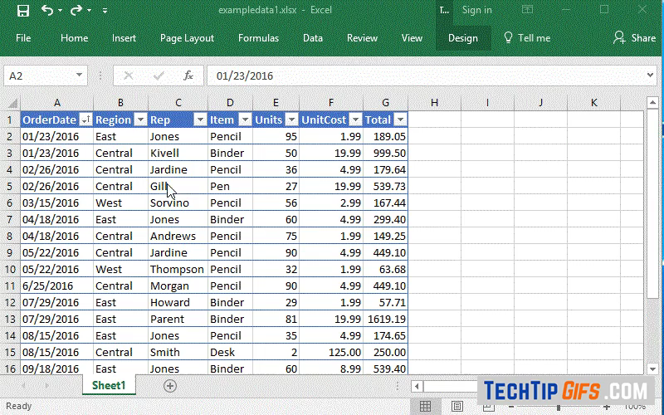
Navigating Within a Worksheet
Use cntrl + arrow keys to move to the end of the contiguous data region
Hold shift to select all the cells traveled through
4
Notes:
4

Slide 5
Using Shortcuts
The alt key brings up keyboard shortcuts to any option contained in the ribbon
We’ll circulate a list of useful shortcuts, but navigating the ribbon using the alt key is the best way to learn excel shortcuts
5
Notes:
5

Slide 6
Fundamentals of Excel Formulas

Slide 7
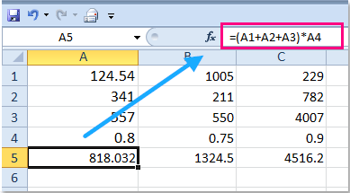
Introduction to the Formula Bar
The formula bar allows you to input instructions into a cell
Raw values can be directly input while calculations require an “=“ sign
You may reference the values contained in other cells by using that cell’s Column and Row address, e.g. (A1)
7
Notes:
7

Slide 8
Relative vs. Absolute References
A huge part of Excel’s value is the fact that you only need to write a formula once, if you write it with relative vs. absolute references in mind
Relative references move along with the cell when pasting or filling
Copy pasting the formula did not work here because the user used a relative reference for cell J2. When the formula was pasted down one cell, the new formula referenced J3, a blank cell
8
Notes:
8

Slide 9
Relative vs. Absolute References (cont.)
To address similar types of situations you will use an absolute reference- one that will not move even when the location of your formula does
Absolute references are denoted by the “$” sign, e.g. “$A$1”. A “$” sign before the letter fixes the reference horizontally. A “$” sign before the number fixes the reference vertically. You may use the “$” sign to lock the row, column, both, or neither
Note in this example the formula is always referencing column B and row 2, as denoted by the “$” to the left of each reference. The other column and row references are left relative to allow the formula to dynamically reflect the values contained in the ranges C2:J2 and B3:B12
9
Notes:
9

Slide 10
Useful Starting Formulas

Slide 11
Booth Analytics Club Excel Cheat Sheet
The Booth Analytics Club has prepared a cheat sheet that covers formulas and shortcuts that are particularly valuable to MBAs starting out with Excel. We’ve included the formulas in the following pages but the cheat sheet itself can be downloaded here.

